Slide 1




Building an
IT Self-Service Portal
Powered by Function App
@PowerShellMich1
Notes:
We did it. It’s the Last Talk of BridgeConf. So we can let our hair down with some RBG and some demonstration on some cool technology.
Also I want to say thankyou to everyone joining. Huge shoutout and thankyou to Thomas, Adillio and Cory. Cory is the unsung here.
#FreeCory
What I will ask is that people keen their questions for the end of the talk.
So we are going to go through all the facets on how I built an IT self service portal
A little about me:
I work as a senior consultant at Insync Technology and I specialize in WinOps automation
I’m am known as that guy. I like to push the boundaries of PowerShell to the limits to see what is possible. For instance a PowerShell Aimbot, Remote Bot and a Stock Market Forum Web Scraper.
Stream Regularly, CoFounder the Brisbane PowerShell User Group and Author (Contributor and Editor for PSConfBookV2, PSConfBookV3)
Enjoying Helping People (Gday Reddit!)
I enjoy running and playing paintball

Slide 2
Questions?
https://pwsh.ca/qanda

Slide 3

Handy Dandy Resources
https://github.com/AzureAD/microsoft-authentication-library-for-js
https://azure.microsoft.com/en-us/services/api-management/
https://docs.microsoft.com/en-us/azure/automation/automation-intro
https://github.com/ZanattaMichael/BrisPug/Presentations/2020/

Slide 4

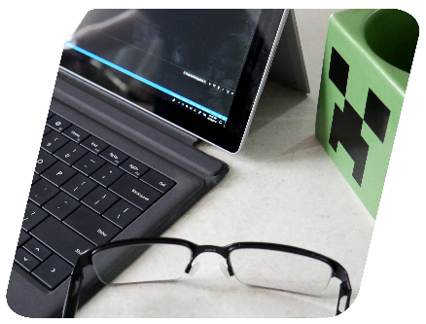
What This is Not
GA
Best Practices
Introduction to C# or PowerShell
Introduction to Function App
Introduction to Azure Technologies
Introduction to MSAL
Notes:
We need to cover what this isn’t:
This is not a fully featured, shippable product. This is more of a Proof of Concept that demonstrates the ingredients to bake a pie. There are bugs within the code and some design flaws. However the premise remains the same.
This does not cover microcode best practices within the community (CQRS / Event Sourcing). (Command Query Responsibility Segregation)
Introduction to C#. We will be assuming that people will have a basic understanding of C#. To be honest if you know PowerShell C# is a hop away.
Introduction to Function App. I won’t be covering the in’s an outs of the function app.
Introduction to Azure Technologies. We will be covering the configuration of these items and logic.
This is not an introduction to MSAL.
All slides are included on github, included with lab scripts.
The environment was build with the AutomatedLab PowerShell Module.

Slide 5
The Challenge
Notes:
So there are 4 goals that we want to achieve here:
Build a Cloud IT Self Service Portal
Must be able to leverage on-premise products
Must be “Serverless” (I mean static)
Must be scalable (We need to be able to add new features to this)

Slide 6
The Solution

Slide 7

The Solution
Notes:
While this graphic seems simple, our IT self service portal will follow the (Request/ Approval & Action) approach.
All requests will be sent from a client (in this instance a serverless portal)
The approvals will be done in Microsoft Teams (since this is the default collaboration source)
Once approval is given , the request is actioned.

Slide 8
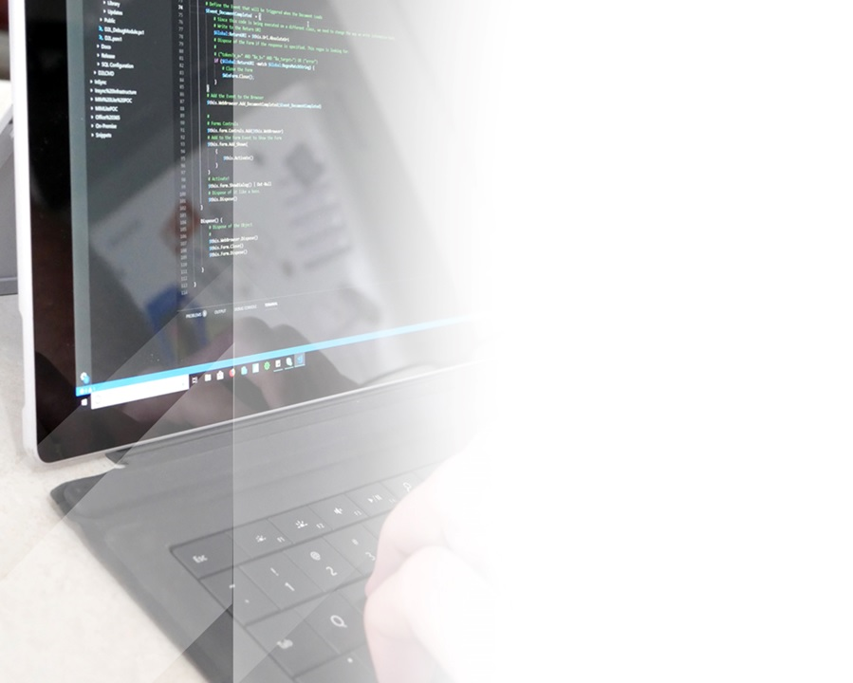
Languages we need
PowerShell
C#
JavaScript
HTML/CSS
Notes:
PowerShell for our heavy lifting
C# for our durable function workflow and front end interface
JavaScript for our client
HTML/CSS for our client

Slide 9
Demonstration – End To End
Notes:
We have seen enough graphics, let’s see an end to end demo!
# Play 01_DEMO_END2END.mp4
File:
In this demo we will show the user opening a page up. Logging into the AAD. (2 Minutes )
Then they will be presented with a list of ‘Things to Do’
They will select a ‘Thing to do’. Fill out the info and hit submit.
Once hitting submit we will move over the approver where they will grant access.
We can then show that access has been granted to the group!
Show the user accessing the resource

Slide 10


Demonstration Adding Features
Client
Azure API Management
Function App
Notes:
This product needs to be scalable. One of the key features of any IT self service portal is the ability to easily add new features to the portal.
So with that in mind let’s take a look at the configuration side of the portal.
Play: 02_DEMO_NEW_TILE.mp4
4. Demo ( Showing how to add another Tile to the Portal )
Load the Existing Portal
Show the Existing Portal and Only Two Tiles
Go into Visual Studio Code and Look at the schema.txt
Note to the audience that the tiles are configured by PowerShell hashtables
Take a copy of the schema and create a new file
Let’s create a tile called AddUserToDistributionGroup
Breakdown:
Runbook PS Object:
Name: The name of the Azure automation runbook to trigger
Parameters: the parameter name and corresponding variable ‘HTML Name’ value
rest body:
Type: The type is the type of configuration. In this instance we can call it AddUserToDistributionGroup
HTMLNameSelected: Is a HTML Name Value of a valute that will be added to that message
HTML Content:
Type: Same as the type in the rest body.
ResponseURL. The rest endpoint to respond to
Title. The title of the Cad
Description. The description of the card.
Owners. The owners of this configuration that the request will be sent to. In this instance it’s hardcoded for these demos, however the sever should perform a lookup in Azure AD to get the Owner group.
HTML Config. This describes what HTML elements are needed to add to the tile
They take a hashtable
HTMLName: The unique name of the element
ElementType: Type of element (Input or Select)
Values (Placeholder items or values). Again this could be dynamically generated by pulling the AD Groups.
Once we have completed the change you can see that the tile is now added. Keep in mind that you will need to add the Azure Automation Runbook.

Slide 11
The Infrastructure
Notes:
Build a Cloud IT Self Service Portal that can action requests on-premise requests

Slide 12



The Layout
REST
PowerShell Helper
REST
REST
Event
Client
Azure API Management
Durable Function
REST
Approval
Approval Process
Notes:
So lets take a look at a technical layout of the Portal. This will help understand how this process hangs together.

Slide 13

Azure App Registration
Notes:
We have seen enough graphics, let’s see an end to end demo!
Play: 03_DEMO_CONFIGURING_CLIENT_ACCESS.mp4
For our client to be able to interact with our API it needs to be able to authenticate with AAD. So we need to build a client app to do this.
Loading:
The App Registration Process is used by the Client (The website) to access the Azure Portal’s resources. This process utilizes OAUTH 2.0 for authentication and authorization.
This is needed so we can get a bearer token for our function app.
Demo:
Select Azure Active Directory
open app registrations
in here we have the automation task client
Note the application client id that’s highlighted
Click on authentication
We need to specify the redirect URI
We need Implicit Grant to be enabled
We need to enabled Multi-tennent account types (What’s supported by MSAL)
We need to expose an API
Add our API scope
Select API Permissions and Add the AutomationTaskClient App.Read. That ensures that we can validate our tokens, if we didn’t use that we would be using Microsoft Graph which we can’t validate.

Slide 14

IAM Function Permissions
Notes:
Let’s take a look at the the IAM function app permissions. This give the function app to the Azure Resources. In this instance we need it to be able to start our Azure Runbooks.
Play: 03_DEMO_CONFIGURING_CLIENT_ACCESS.mp4
Open resource groups
select PowerShell summit
Scroll down to the bottom
select PS helper azure function
Select platform features
Select identity
wait for the load
turn the status on
note the object ID
Select the parent resource group
select access control IAM
Quick add role assignment
Select the role (I’m adding owner)
Under assigned access to : select function app
Select the Function App
Click Save

Slide 15

Azure API Management
Notes:
Azure API management, provides a centralized API endpoints, control-flow and authentication for difference services. In this instance we will be using it to centralize our Function App and Logic Apps.
APIM acts as a proxy services to the other API endpoints.
Select Resource Groups
Scroll Down and Select PSSummit APIM
Select APIs
Note the Three APIs Added:
Automation Task (Durable Functions)
PSHelper (PowerShell Helper)
TeamsApproval (Logic App)
Note that we are proxying through APIM. We are doing this by using APIM published URLS not what’s provided in each microservice.
Select Automation Task:
Note the endpoints:
Initialize
InvokeApprovalResponse
InvokeRequest_HttpStart
Select the CORS Policies:
Note the Allowed Origins
Note the Methods
Note the Headers
Select the PSHelper:
Note the cors policies are default
Select Settings. Note that a subscription key is required
Select Teams Approval
Note the cors policies are default
Select Settings. Note that a subscription key is required
TO ADD SUBSCRIPTION KEY:
Select SubscriptionsL
Click Add Subscription
Provide Name
Provide Display Name
Provide Scope / API
Select the APIs
Select Save
ADDING a Function:
Select Function App
Select Browse
Select Configure Required Settings
Select The Function App (Select HotCopperUserSentiment)
Click Select
Select the Function Click Select

Slide 16
The Function App

Slide 17

The Client Workflow
Azure AD
Step 1: Obtain Access Token Using MSAL
Response: Bearer: NeverGonnaGiveYouUp
Step 2: Get App Tile Configuration /Initialize
Response: { “Configuration” : “NeverGonnaGiveYouUp”}
Client App
Step 3: Send a /InvokeRequest_HttpStart
Function App
Notes:
To fully understand the API endpoints we need to talk about the client workflow. This is the technical process from the client side that is used to interaction with the API endpoint.

Slide 18
\Initialize Workflow
GET \Initialize
REST Token
PowerShell Helper
Function
(Get-Configuration)
Initialization
Token Validation
Get Configuration
JSON Response
REST Configuration Response
Notes:
So let’s look at the process of the Initialization Workflow
Break down the workflow:
Initial Request is posted with the header
Once the Initialization is trigged.
The token is validated. The user is retrieved.
(On first run) The Configuration triggers a helper function to compile the configuration
The configuration is returned and cached
Returned to the configuration to the client

Slide 19
\Initialize Workflow
GET \Initialize
REST Token
PowerShell Helper
Function
(Get-Configuration)
Initialization
Token Validation
Get Configuration
JSON Response
REST Configuration Response
Notes:
Let’s then a look at the code!

Slide 20
Demonstration – Configuration
PowerShell Helper
Function
(Get-Configuration)
GET \Initialize
REST Token
Initialization
Token Validation
Get Configuration
JSON Response
REST Configuration Response
Notes:
Let's take a look at the client helper so we're going to start the function
I'm gonna go browse to that URL Endpoint
once returned you can see we have a Jason array up to configuration data
note that the configuration data appears to be the sa me as the PowerShell file/ while it is similar there is a custom dll that compiles the configuration so that’s c# can parse it

Slide 21

Request Function Workflow
\InvokeRequest
PowerShell Helper
(Configuration)
POST \InvokeRequest_HttpStart
Change
POST \Validate
Response
POST
Token Validation
Configuration Validation
Request Approval
REST
\InvokeRunbook
REST
Runbook Starts
PowerShell Helper
(Start Runbook)
Prepare For Runbook Execution
Approval Event
Notes:
So let’s take a look at a request being submitted from the client:
The client submits the request. In this request the configuration is passed in the HTTP body from the client to the function app
Function app then triggers
to convalidation is performed
Then the configuration validation is performed.
This process is performed by our PS Helper Again.
This is looking for any anomalies
Then the approval is requested.
From here the workflow will wait for the approval to be granted
Once approval has been granted, the PowerShell helper will be invoked again

Slide 22
Demonstration – Durable Function
PowerShell Helper
(Configuration)
POST \InvokeRequest_HttpStart
Change
POST \Validate
Response
POST
Token Validation
Configuration Validation
Request Approval
REST
\InvokeRunbook
REST
Runbook Starts
PowerShell Helper
(Start Runbook)
Prepare For Runbook Execution
Approval Event
Notes:
Exploring the process (Durable Function) : (3 Minutes)
Look at the RequestSchema (Get Method) be sent to the user. Rather then writing code, we an write configuration.
Discuss Authentication Context (Function)
This sends information to the user, providing a JSON object of what URL endpoints and body it’s expecting from a schema.
Note that this is a static string, however you would build a JSON object to send to the user based on information from AAD
Show a demo JSON
(Quick Video of this action) -> DEMO_GET_CONFIGURATION.MP4
Look at the NewRequest (POST) Durable Function: (16 Minutes)
Discussion Authentication Context (Function)
Token Validation with Function calling activity function.
Validating Author
Deserialize JSON Body Request.
Validating the body of the request against a schema
Validating the dataset with the body
Getting the Approval Owners (Reading AD Group and Getting Owner) (Worst comes to worst, raise a HTTP and get the AAD Group and AAD Group Owner)
Sending the Approval. (Mention, but will be discussed in the Approval Demo)
Waiting for an event to be raised. (Mention, but will be discussed in the Approval Demo)
Actioning that event with an automation runbook.
Exploring that code on how to run a runbook. (Worst comes to worst, raise an HTTP Post to a PowerShell Function)
(Quick Video of this action) – Show the instance id that is returned, this is needed by the approval to approve the event.
Setting up our Apps (6 Minutes)
Function Deployment
Deployment of the Function and Configuration of Changes
Deployment of the PowerShell Helper
Enablement of System Idendity within Azure
Access to the Automation Account
APIM Implementation
Import of the APIM Helper Functions and Logic App
Under Automation Task (Being the Front End) will have a CORS policy:
Show CORS policy
Allow All Origions is allowed, however this should be locked down
Show Subscription Options.
Allow GET/POST & OPTIONS
Allow the following Headers: Content-Type/ Authorization/ Access-Control-Allow-Origin
Now APIM can validate the token, however in this instance the function validates the token.
The other functions are stock standard. They require a subscription key.

Slide 23
Request Function Workflow
\InvokeRequest
PowerShell Helper
(Configuration)
POST \InvokeRequest_HttpStart
Change
POST \Validate
Response
POST
Token Validation
Configuration Validation
Request Approval
REST
\InvokeRunbook
REST
REST
Runbook Starts
PowerShell Helper
(Start Runbook)
Prepare For Runbook Execution
Approval Event
Notes:
Let’s take a look at the Configuration Validation

Slide 24
The Client
Notes:
Build a Cloud IT Self Service Portal that can action requests on-premise requests

Slide 25
Demonstration – The Client
Azure API Management
Client
Notes:
In this demo we are going to demo the client interactions. So we need to explain the following:
0. Demo Configuring the Client ID:
Authentication Process:
Using MSAL Authentication Library to get the token information
Reviewing the Code:
Show the configuration of the webpage:
URL Endpoint and subscription key.
Document_OnEventLoaded
–Prompt for login:
The initial request for content
Show JavaScript used to dynamically build the functionality out from the schema.
Using that information, show the functions to POST information to the Azure API
Show How the Client Compiles and Sends the Body according to the Schema.
Remind that the schema is validated, so users can change the request, however it won’t be successful.
Log Errors.
Show demo of this happening:
Me loading the page,
Authing
Editing the JSON configuration
Sending to client.
Watching the rejection.
Configuring Client Access – App Registration - DONE
Note: Client ID
Authentication:
Configuration of Redirect URI’s
Enable Implicit Grant of Access and ID Tokens (Required for JS MSAL)
Supported Account Types: MultiTennent (Required for JS MSAL)
Now we need to expose and API
Scope Name:
Api:// blah
Add API Permissions:
Demo( We need to demo deploying onto Static Blob Storage)
Deploy to Blob Storage
Try and run the website. Show the errors
Show process of create azure function proxy and adding cors-overwrite-header
This can be done by adding proxies.json file to the function app
Show Proxies.json file
Make changes
Load and run

Slide 26
The Approval Process
Notes:
Build a Cloud IT Self Service Portal that can action requests on-premise requests

Slide 27
Request Function Workflow
\InvokeRequest
PowerShell Helper
(Configuration)
POST \InvokeRequest
Change
POST \Validate
Response
POST
Token Validation
Configuration Validation
Request Approval
REST
\InvokeRunbook
REST
Runbook Starts
PowerShell Helper
(Start Runbook)
Start the Runbook
Wait for Approval Event
Notes:
In this demo we will review the approval process:
Creation of the Approval Request Function
Note that is calling a logic app stored in the configuration
Note that we are waiting for a response event to be raised.
Review the Logic App.
THIS IS A DEMO
Note the teams process writes the content in a DM to the person (not a channel).
Note the Instance ID. Explain that instance corresponds to the durable function instance ID.
User can Client APPROVE or DENY.
Notice that it calls the eventing function. Note that this does not go through the APIM (Being Internal)/
Review function:
Review the JSON Body.
Raise the event based on the response.
Note that we are using the instanceID
Play: 09_DEMO_APPROVAL_LOGICAPP.mp4

Slide 28
The Action

Slide 29
Request Function Workflow
\InvokeRequest
PowerShell Helper
(Configuration)
POST \InvokeRequest
Change
POST \Validate
Response
POST
Token Validation
Configuration Validation
Request Approval
REST
\InvokeRunbook
REST
Runbook Starts
PowerShell Helper
(Start Runbook)
Start the Runbook
Wait for Approval Event
Notes:
In this demo we are going to review the actioning of the Request:
Show the Runbook Starter Code in the Helper
Show Configuration of Azure Automation
Show Configuration on Run As Accounts
Show Runbooks
Show Runbook Code

Slide 30
Summary
Notes:
We Explored the Processing of Setting up and Configuring our Infrastructure
We reviewed the layout
We reviewed the architecture
We reviewed the function apps
The client
Azure Automation runbooks.

Slide 31




Thankyou!
@PowerShellMich1
https://github.com/ZanattaMichael/BrisPug
https://twitch.tv/PowerShellMichael

